Slide 1

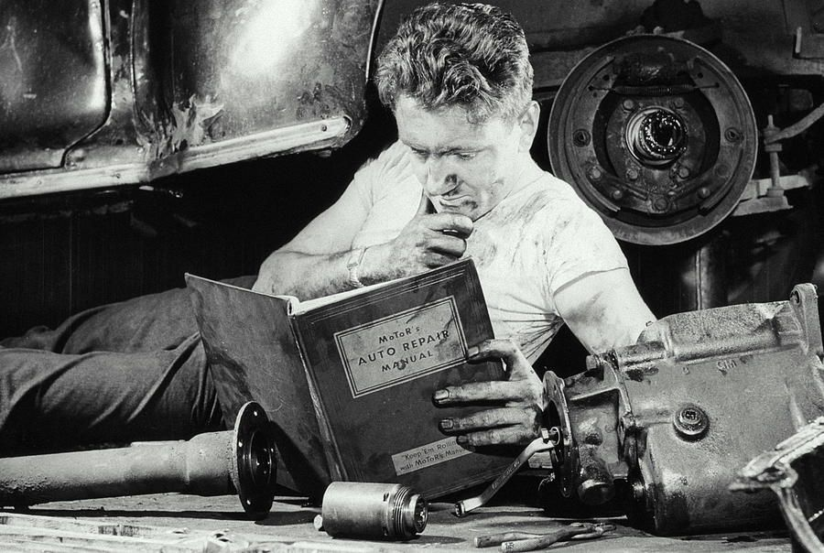
Problem? Mechanics nowadays handles lot of different vehicles.
Requires research
Need to step back from doing repairing
instead go look for information like
searching in auto repair manuals
Source: https://shorturl.at/hnGPT

Slide 2
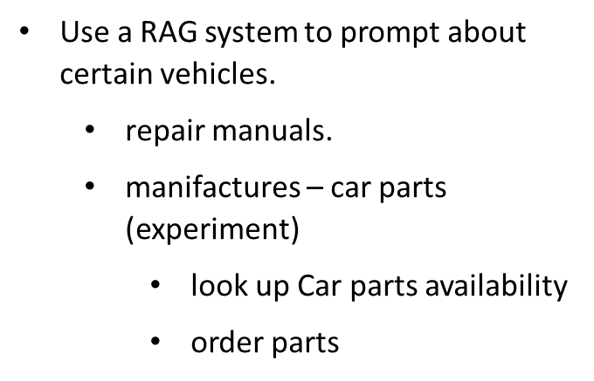
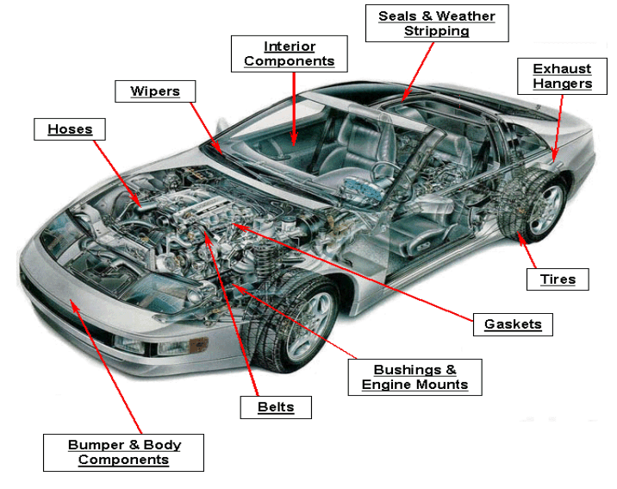
Source: https://shorturl.at/tZ258

Slide 3
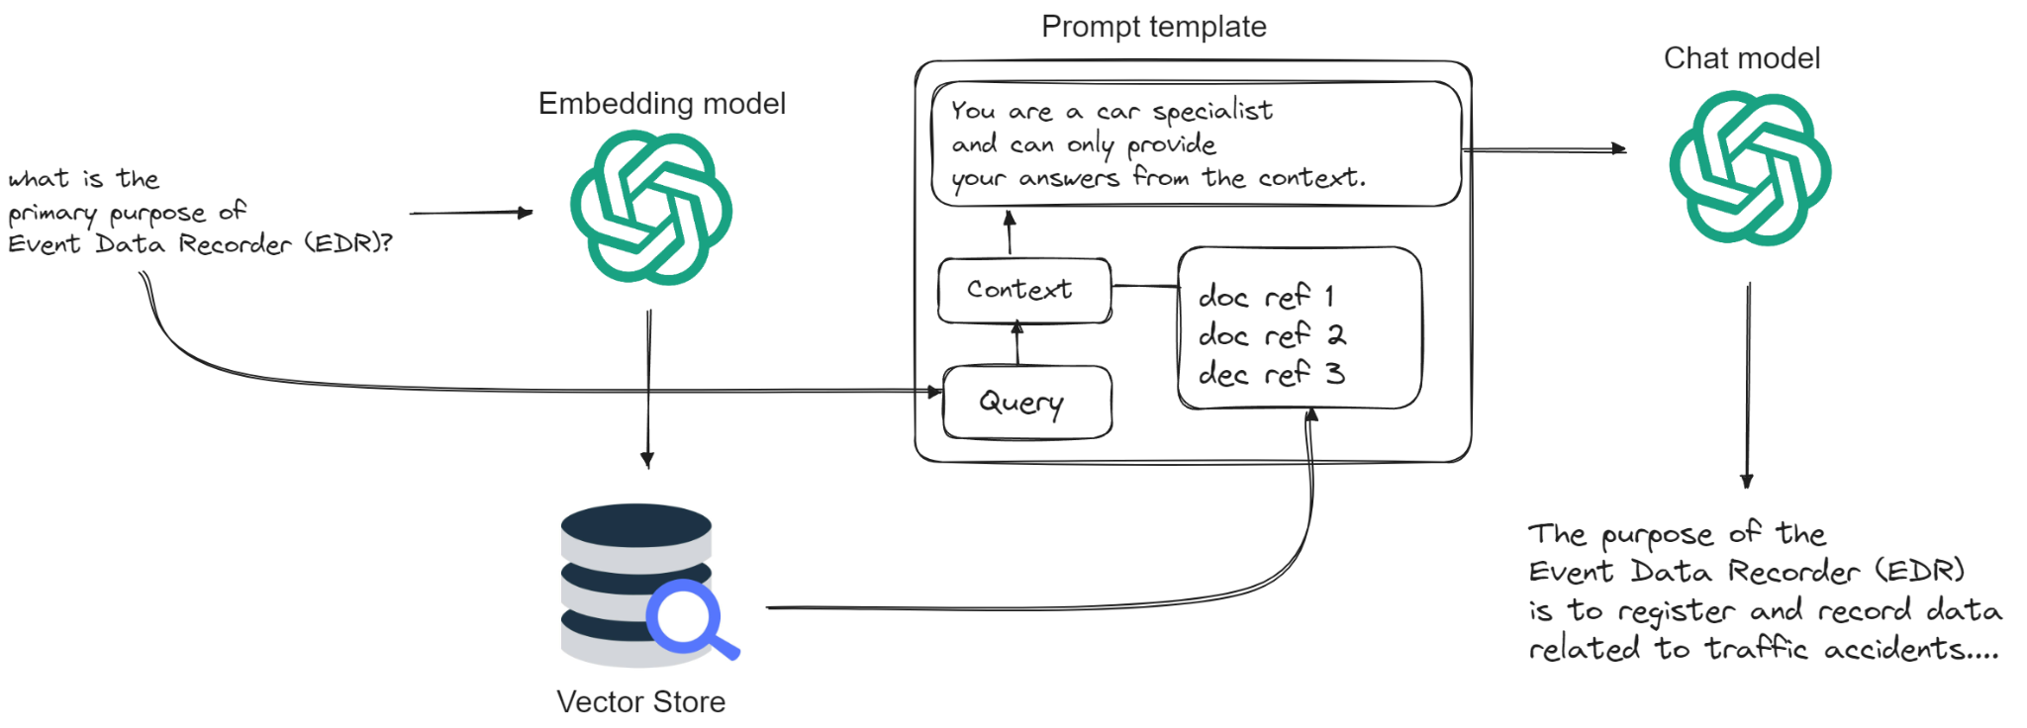

Slide 4
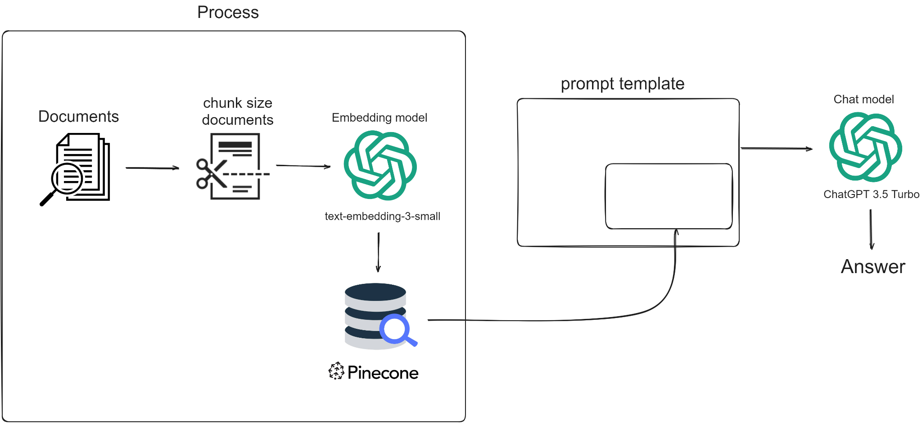

Slide 5
So how would mecAInic look like in practice?

Slide 6

What is the next step?
Validating the mechAInic RAG system
How well does the MecAInic RAG perform on question answering?
Experiment with using assistants and see how that fit in with the RAG system

Slide 7
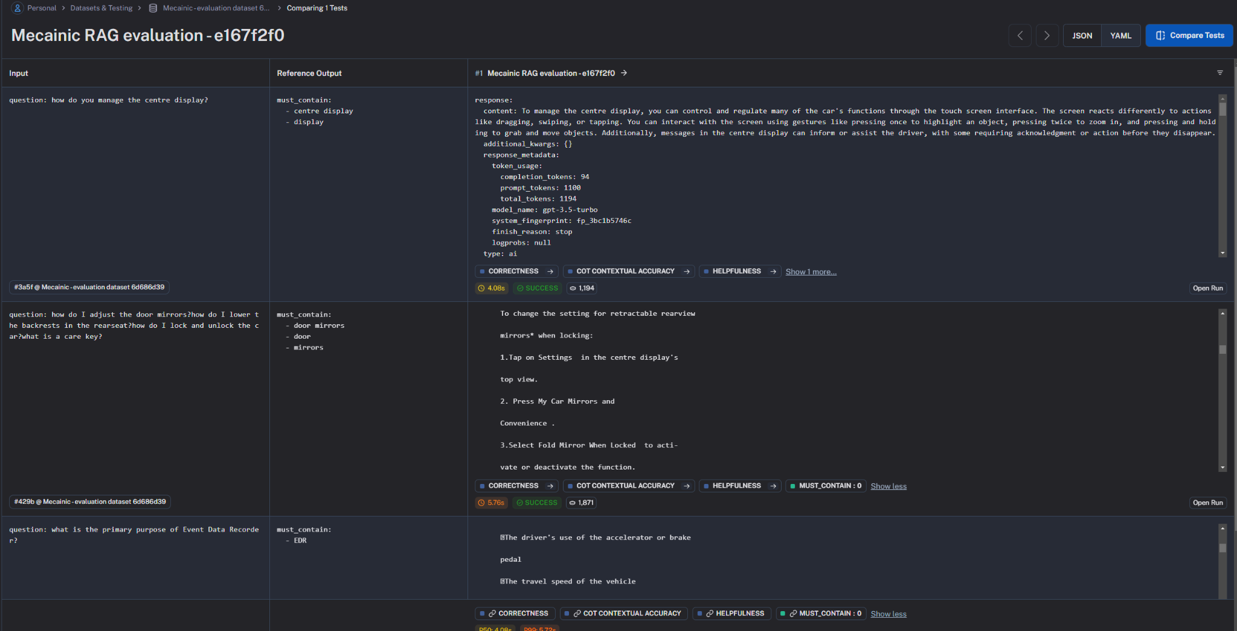

Slide 8
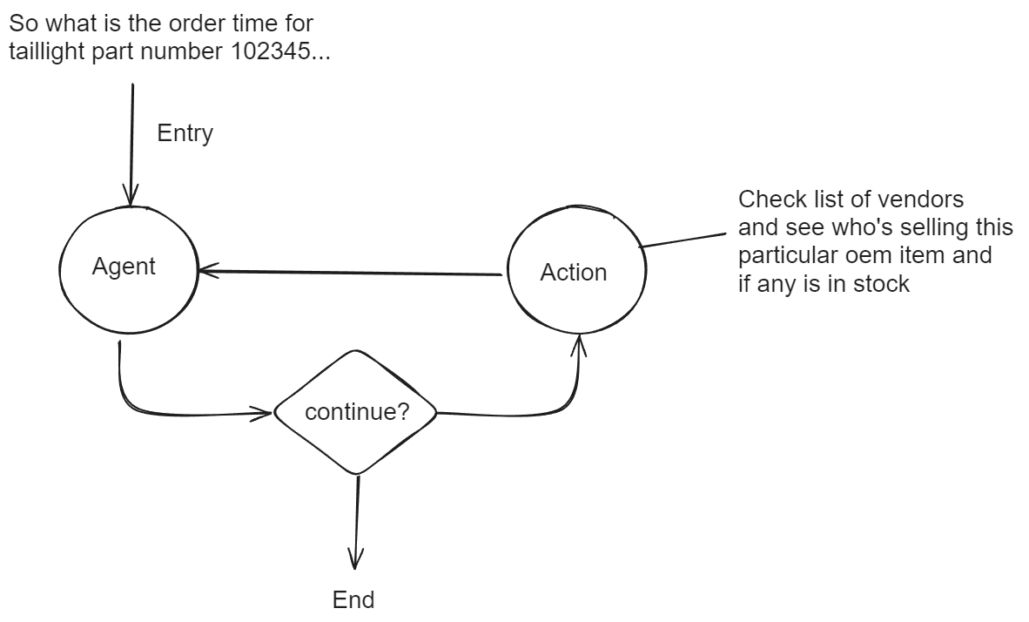
Experiment - car parts availability & order?

Slide 9

That’s it folks! Thanks for listening!

